Slide 1

Welcome to the Club
CCDC
CTF this weekend

Slide 2
Icebreaker
One Word Story

Slide 3
One PicoCTF Problem

Slide 4
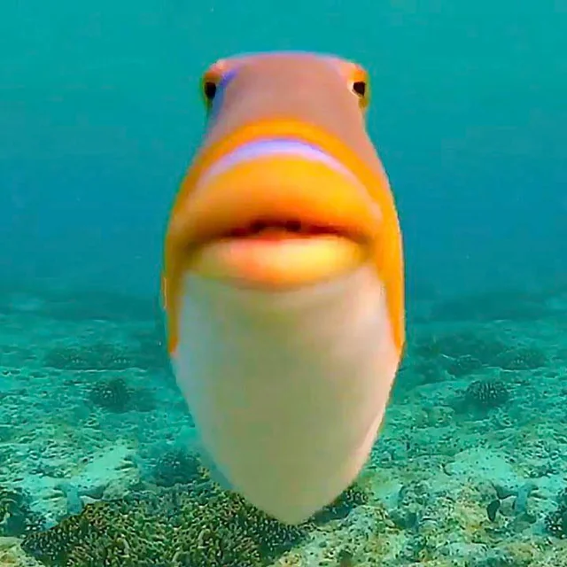
Phishing Payloads
By Andrew Bernal

Slide 5
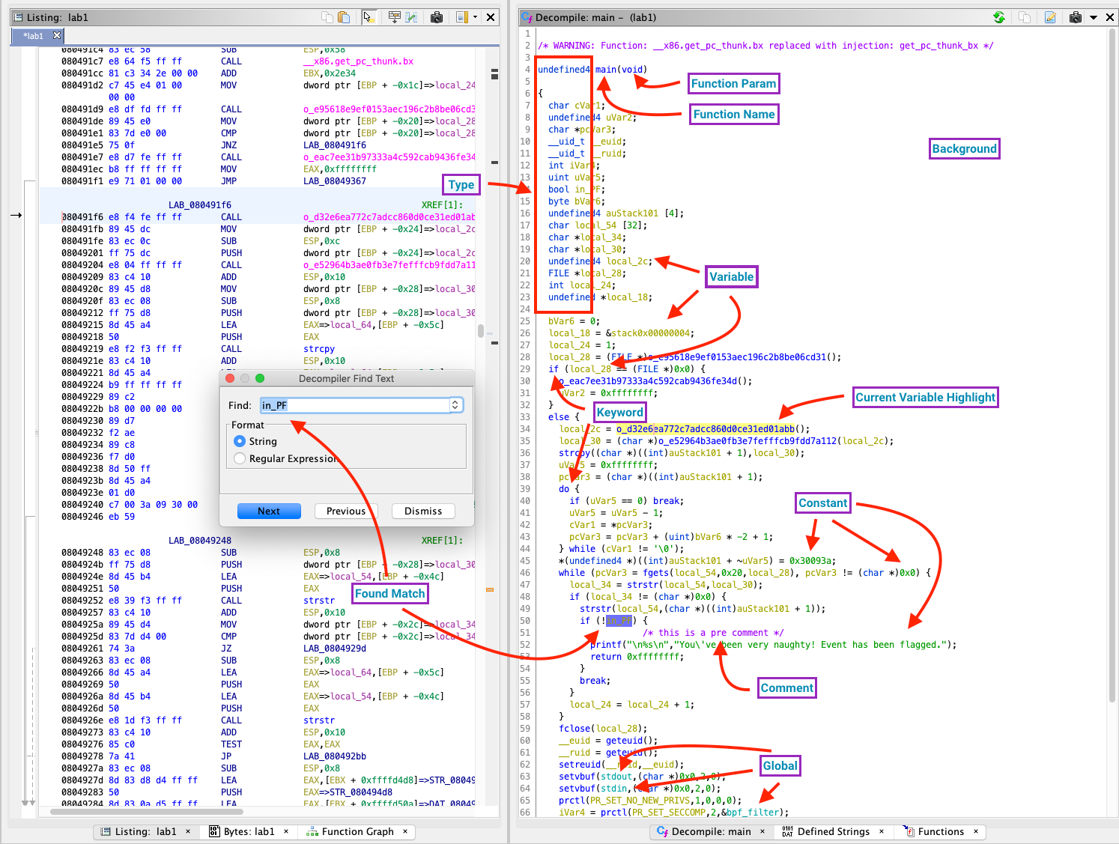

Slide 6
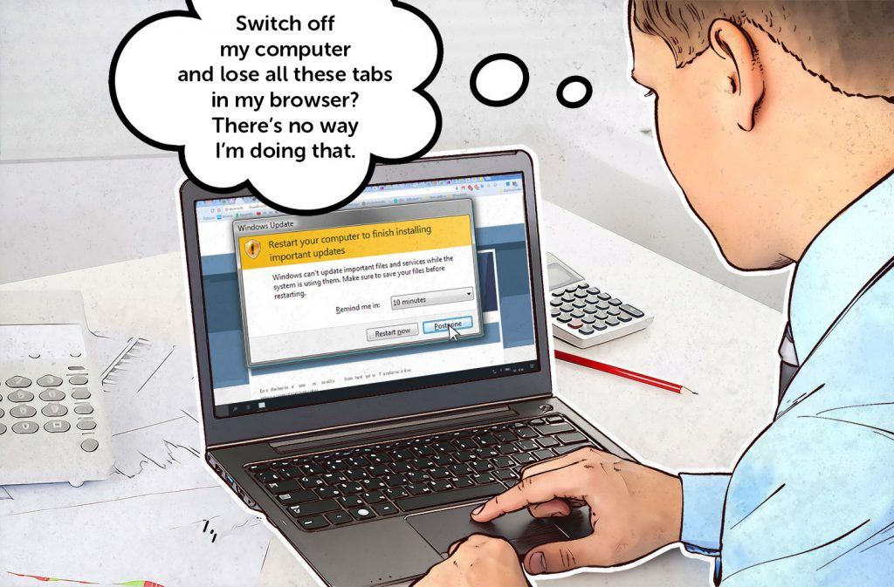

Slide 7
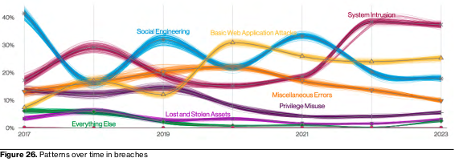
Attacks over time

Slide 8
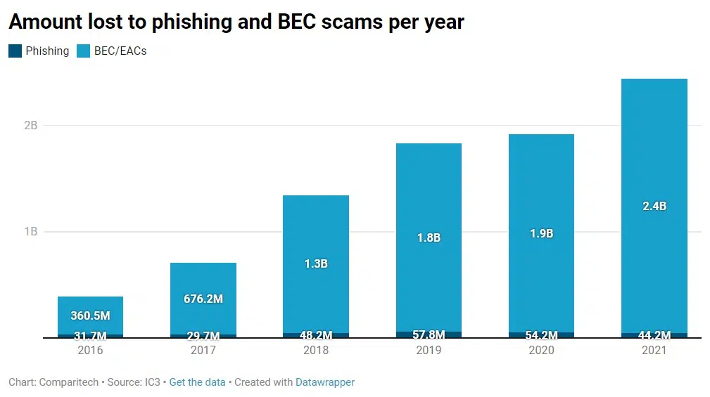
Profitable

Slide 9
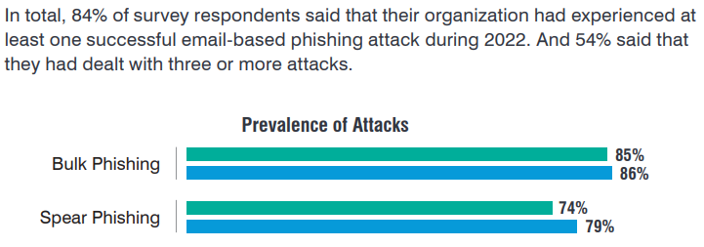
Effective

Slide 10
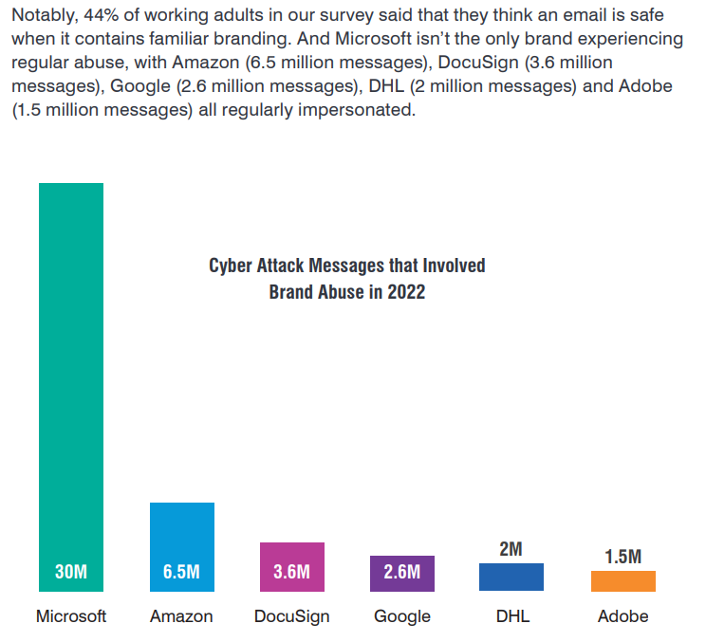

Slide 11
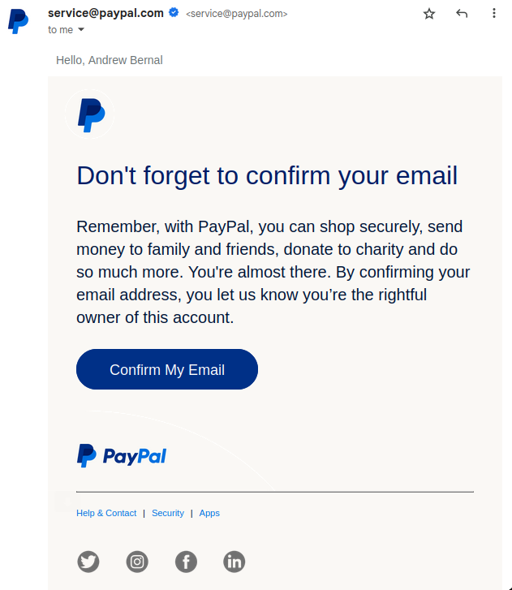
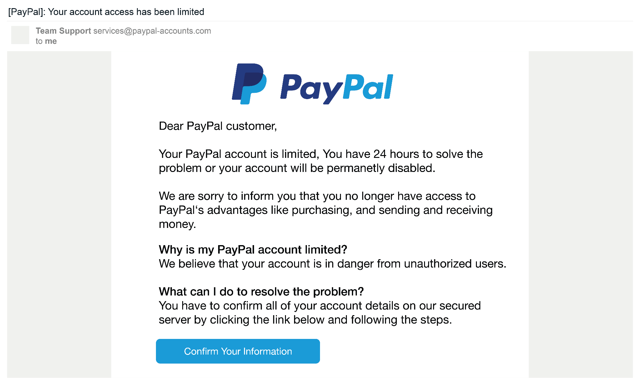
Example Phishing Email

Slide 12
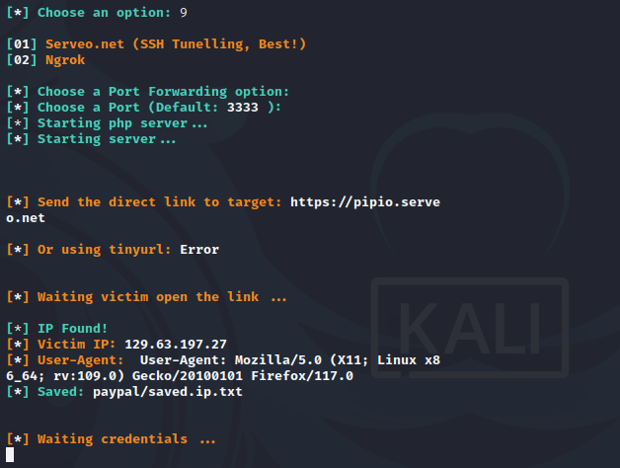
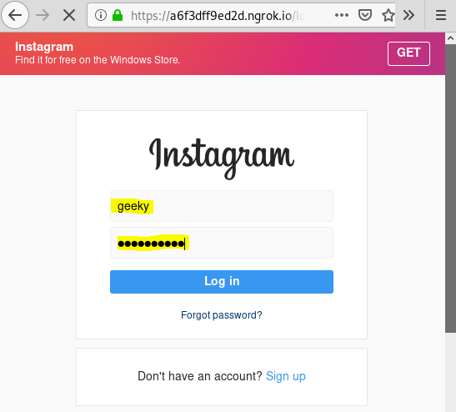
Fake websites with SocialPhish

Slide 13
Homographic Attacks - ASCII
Capital i and lowercase L
I l
Other examples:
0 vs O
rn vs m
n vs m
i vs j
1 vs l

Slide 14
Which is real?
https://login.microsoftonIine.com/
https://login.microsoftonline.com/

Slide 15
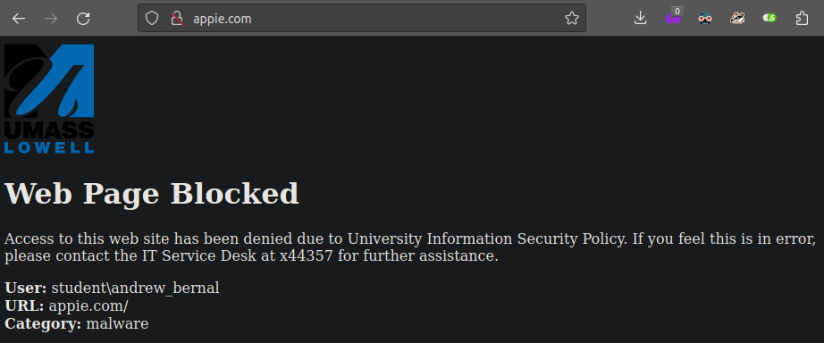
appie.com

Slide 16
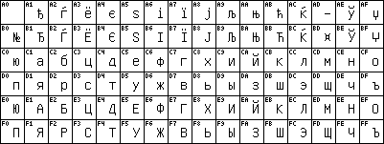
Homographic Attacks - Unicode
Cyrillic, Greek, Armenian, and more
Cyrillic Keyboard

Slide 17
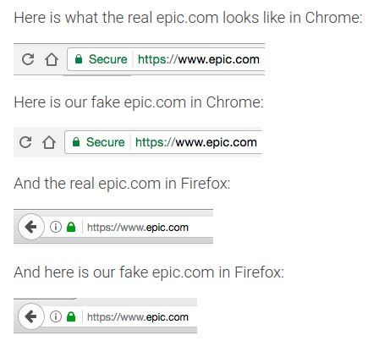
Spelling epic.com with cyrillic

Slide 18
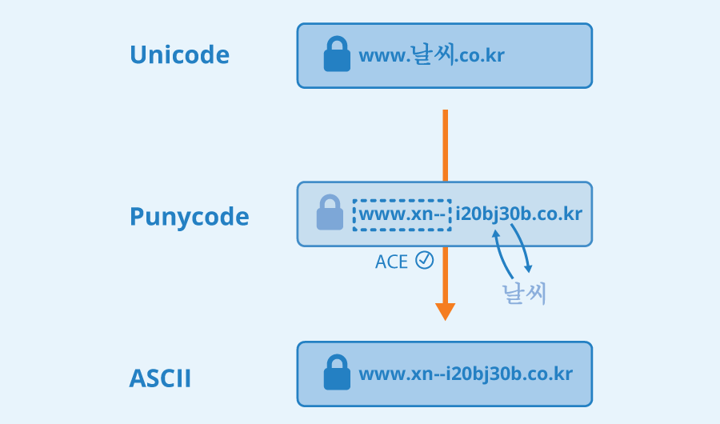
Punycode: solving homographs

Slide 19
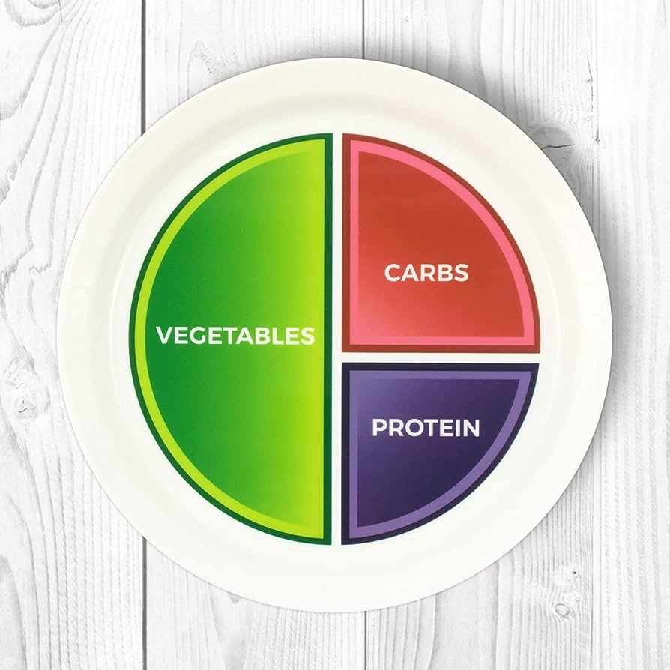
Macros
Visual Basic for Applications (VBA)

Slide 20
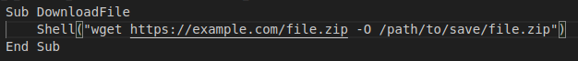
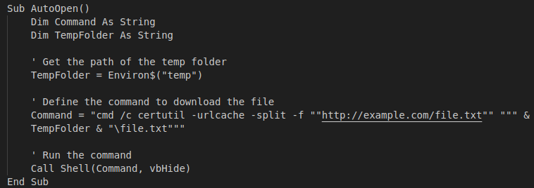
Possible Macros
LibreOffice getting a shell:
Word getting a shell
(cmd, not powershell):

Slide 21
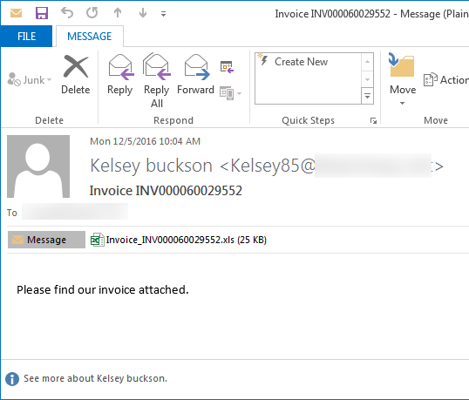
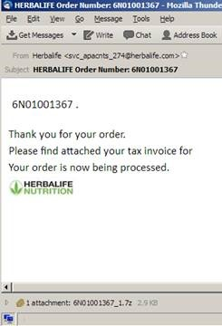
Locky Ransomware 1

Slide 22
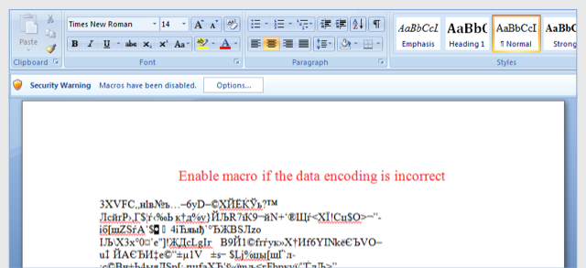
Locky Ransomware 2

Slide 23
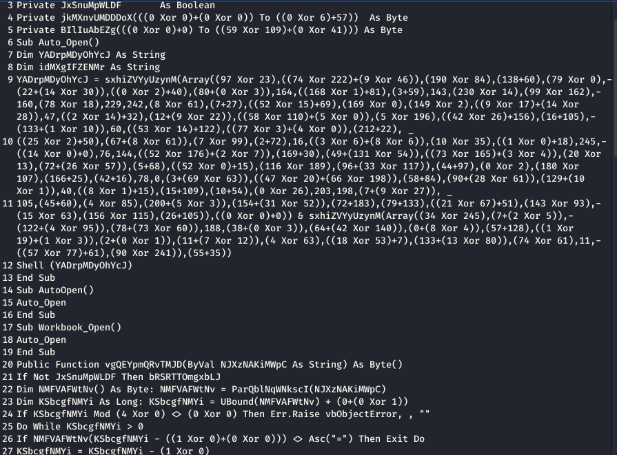
Obfuscating VBA

Slide 24
exe files
Very suspicious
Can make exe have any icon
How to make less suspicious?

Slide 25
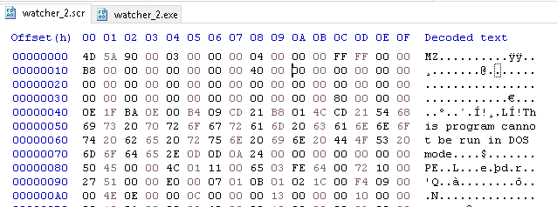
.scr files
Screensaver
Same as an exe

Slide 26
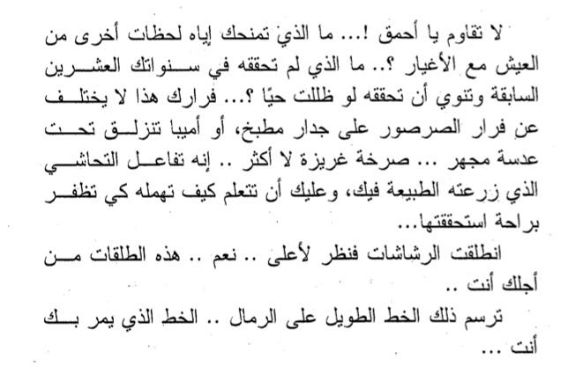
RTLO Character
Right to Left Override

Slide 27
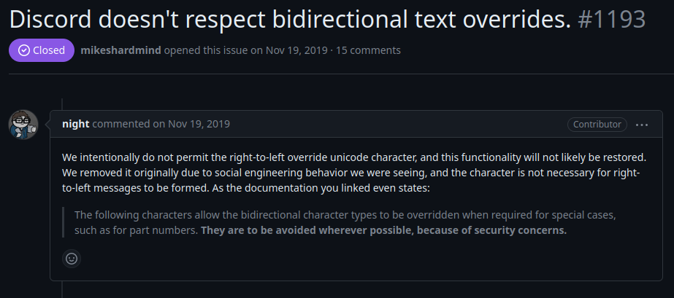
RTLO Character blocked by discord

Slide 28
Putting it all together
watcher_1.<RTLO Character>fdp.scr
becomes:

Slide 29
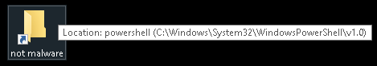
.lnk files

Slide 30
Lab: Making Phishing Payloads
Go to https://umlcyber.club/posts/meeting_1
Or https://github.com/UML-Cyber-Security/Fall_2023/blob/main/Meeting_1_Phishing_Payloads/lab_1.md
If you want, send me an email at phishing.victim.uml@gmail.com and I will open them
Use Google, Bing Chat, ChatGPT to help you. They are useful tools.

